Slide 1
Modeling The Evolution Of COVID DSIP Fall 2021
Ashutosh Godbole
FNU Shikha
Pooja Kusuma Pillutla
Raymond Adams

Slide 2
Project Overview & Highlights
This project is a continuation of the work done in previous semester.
Covid spread is dependent on various factors such as socioeconomic, demographics, social measures and later to vaccinations.
This phase of the project aims to study (if there exists) the impact of socio-economic and demographic factors on the spread of COVID
Research question - Are various sub variants of the virus similar in the way they spread/affect?

Slide 3
Data Description
Data is taken from internet/govt sites.
Major socio-economic factors included are :
Age, Population Density, Literacy and Education Index, Ethnicity, etc..
We have considered case level and county level data for our analysis.
There are different constraints to analyze specific factors and define data like
-Different variants of COVID
-Attitude towards Vaccination
-Social-distancing measures at different sites like park, schools, malls etc

Slide 4
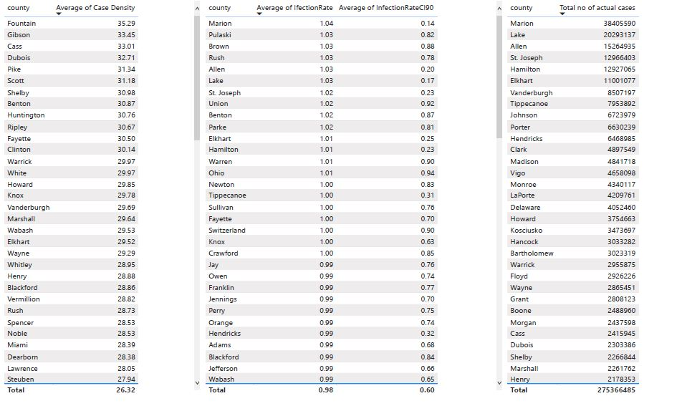
Analysis & Results

Slide 5
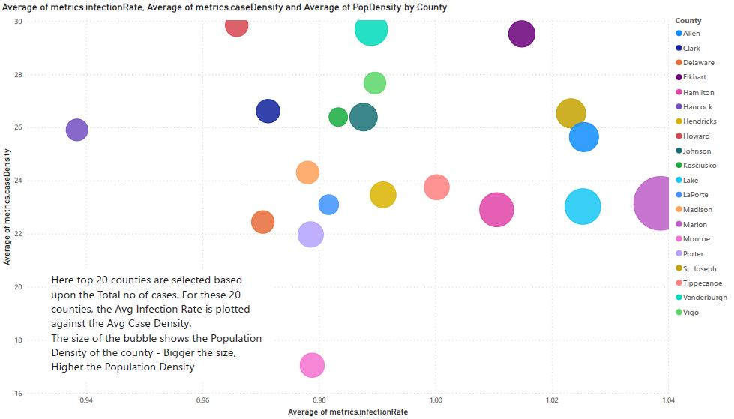
Analysis & Results (Contd..)

Slide 6
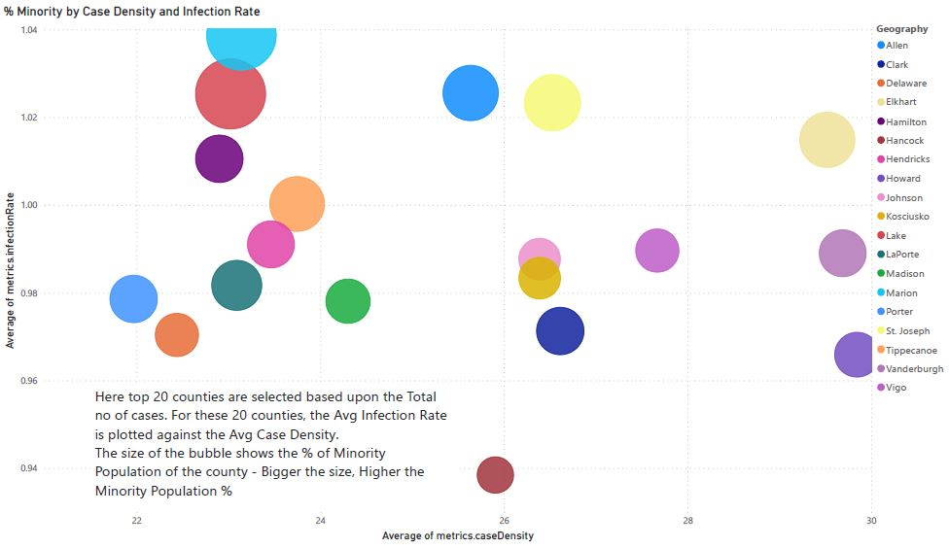
Analysis & Results (Contd..)

Slide 7
Conclusion & Recommendations:
Conclusion
Recommendations
Vanderburgh - high case density but low infection rate.
Kosciusko and Rush counties have the lowest population density yet high case density and infection rates.
Look for other health and demographic related data and try linking it to case data
Finding data pertaining to Covid Variants should be considered
Continuing analysis to the year 2021

Slide 8
Thank You

